Slide 1
Introduction to Deep Learning

Slide 2
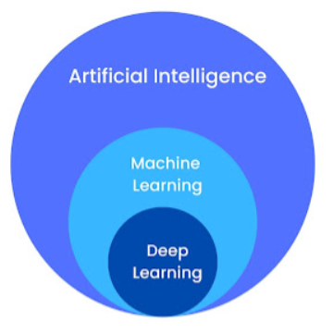
What is Deep Learning?
Deep Learning is a subset of machine learning involving neural networks with many layers.
Designed to automatically learn representations from data by using a hierarchy of multiple layers that progressively extract higher-level features from the raw input.

Slide 3
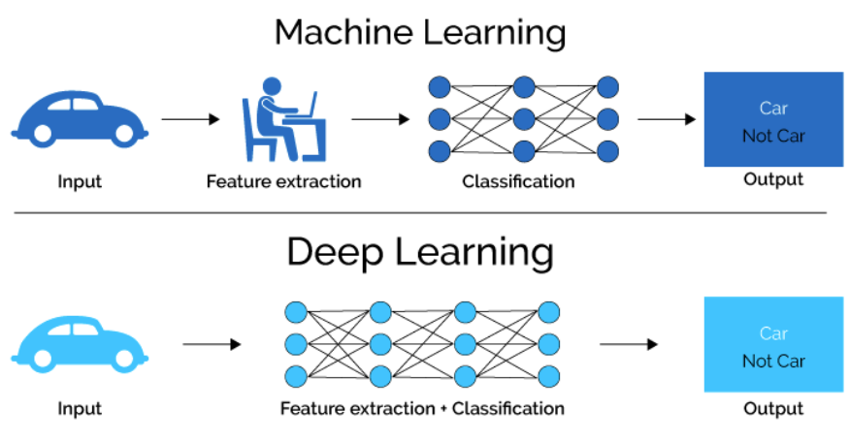
ML vs DL

Slide 4
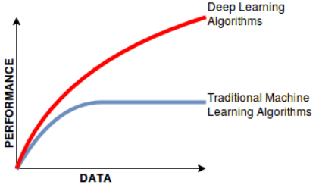
Why it is so popular?
Performance
Data Availability
Computational Power
Algorithmic Advancements
Open-source Ecosystem
Versality

Slide 5
Neural Network
Neural Network: A computational model inspired by the way biological neural networks in the human
brain process information.
Purpose: To identify patterns, classify data, and make predictions by learning from data.

Slide 6
Activation Function
Introduce a non-linearity in the network
Decide whether a neuron can contribute to the next layer
Step Function
If value > 0
Else
0 is “Threshold”

Slide 7
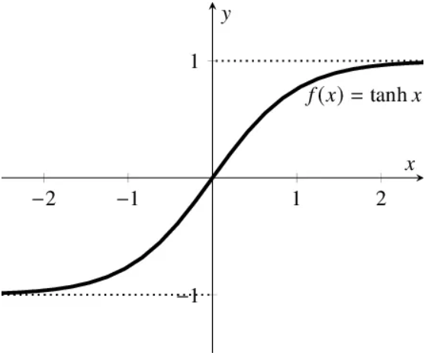
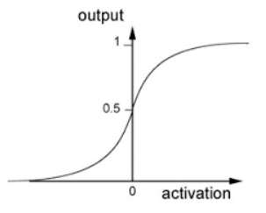
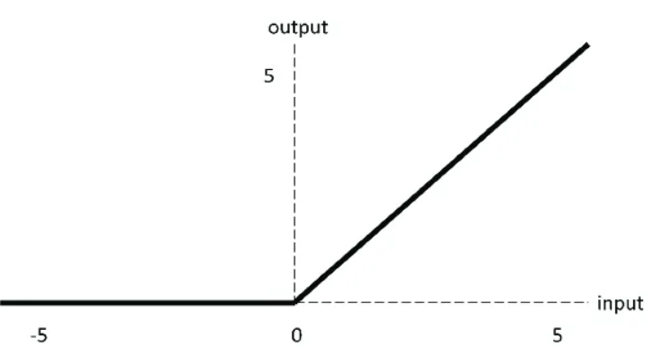
a)Sigmoid Function
b)Tanh Function
c)ReLu Function

Slide 8
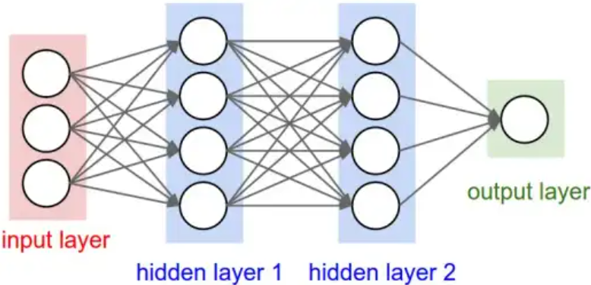
FeedForward Neural Network

Slide 9
CNN
A Convolutional Neural Network is a type of deep learning model specifically designed for processing structured grid data, such as images. CNNs are particularly effective for tasks involving image recognition, classification, and computer vision.
The Convolutional layer applies filters to the input image to extract features, the Pooling layer down samples the image to reduce computation, and the fully connected layer makes the final prediction. The network learns the optimal filters through back propagation and gradient descent.
Eg ; YOLO v2

Slide 10
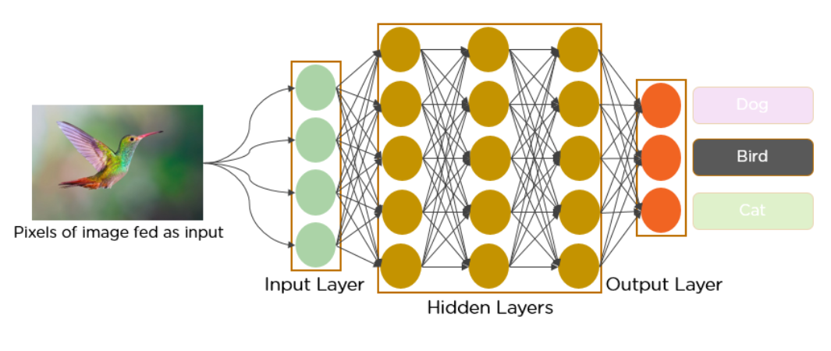
How it works

Slide 11
Recurrent Neural Network
Recurrent Neural Networks (RNNs) are a type of artificial neural network architecture designed to handle sequential data. Unlike traditional feed forward neural networks, RNNs maintain an internal state memory, helping them to recognize patterns in sequences of information
This makes them suitable for various tasks, including NLP, speech recognition, and time series prediction.

Slide 12
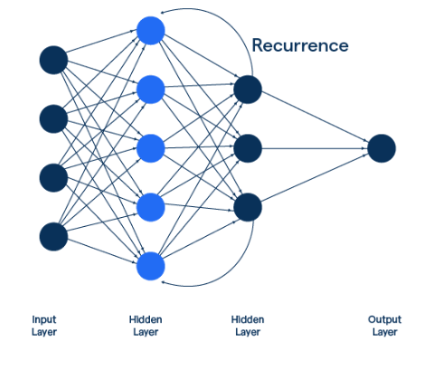
How it works?

Slide 13
LSTM
Long Short-Term Memory is an improved version of recurrent neural network designed by Hochreiter & Schmidhuber.
A traditional RNN has a single hidden state that is passed through time, which can make it difficult for the network to learn long-term dependencies. This model address this problem by introducing a memory cell, which is a container that can hold information for an extended period.
LSTM architectures are capable of learning long-term dependencies in sequential data, which makes them well-suited for tasks such as language translation, speech recognition, and time series forecasting.

Slide 14
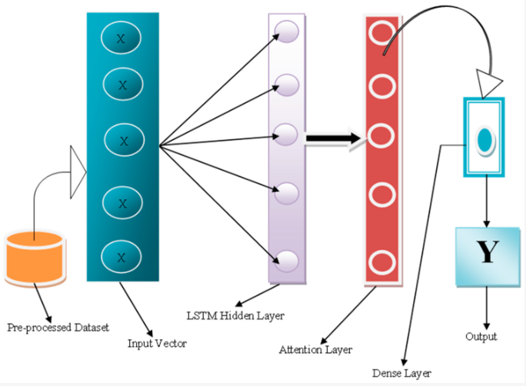
How it works?

Slide 15
Application
Computer Vision
Natural Language Processing
Autonomous Vehicles
Healthcare
Robotics

Slide 16
Challenges
Data Requirements
Computational Power
Interpretability
Generalization

Slide 17
Conclusion
Deep Learning: Neural networks with multiple layers.
Neural Networks: Neurons, weights, biases, activation functions.
Forward & Back propagation: Making predictions and learning from errors.
Applications: Computer vision, NLP, healthcare, autonomous vehicles.
Challenges: Data requirements, computational power, interpretability, generalization

